Slide 1
A project on Book Recommendation by Alsaba Abdul Gafoor Shaikh
College seat no.-S20121
University seat no.-4032069

Slide 2
Problem Description During the last few decades, with the rise of YouTube, Amazon, Netflix, and many other such web services, recommender systems have taken more and more place in our lives. From e-commerce (suggest to buyers articles that could interest them) to online advertisement (suggest to users the right contents, matching their preferences), recommender systems are today unavoidable in our daily online journeys. By analyzing the problems with ‘Book Recommendation System’ feature, how we can predict the best recommendation for users according to their items approach. A recommendation system helps an organization to create loyal customers and build trust by them desired products and services for which they came on your site. The recommendation system today is so powerful that they can handle the new customer too who has visited the site for the first time. They recommend the products which are currently trending or highly rated and they can also recommend the products which bring maximum profit to the company. Providing specific data analysis and prediction to done with this data. The main objective is to built a predictive recommender model, which could help in predicting – how we can predict the best recommendation for users according to their items approach. This would help us in providing better recommendation item to a right specific users.

Slide 3
Data Description:
We have three datasets:
●User:
User-ID, Location, Age
●Books:
ISBN ,Book-Title ,Book-Author, Year-Of-Publication, Publisher
Image-URL-S, Image-URL-M ,Image-URL-L
●Rating:
User-ID ,ISBN, Book-Rating

Slide 4
EDA
Users Shape:
(278858, 3)
Rating Shape:
(1048575, 3)
Books Shape:
(271360, 8)

Slide 5
Books Dataset
Shape :- (271360, 8)
Null values:- Book author = 1
Publisher = 2

Slide 6
Ratings Dataset
Shape :- (1048575, 3)
Null values:- No null values

Slide 7
UsersDataset
Shape :- (278858, 3)
Null values:- Age = 110762

Slide 8
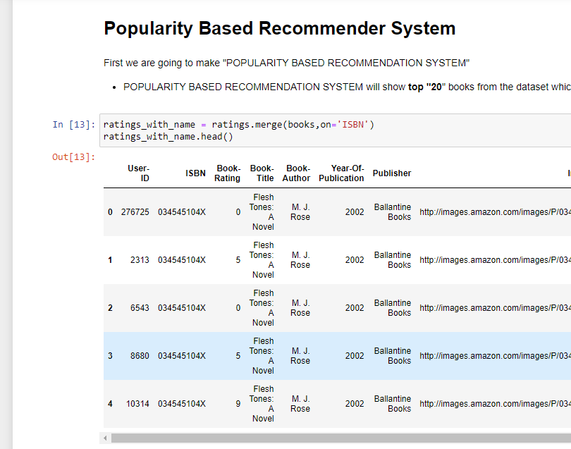
Popularity Based Recommender System
In popularity based recommender system firstly taking top 20 books from the dataset which has minimum 250 ratings by users.

Slide 9
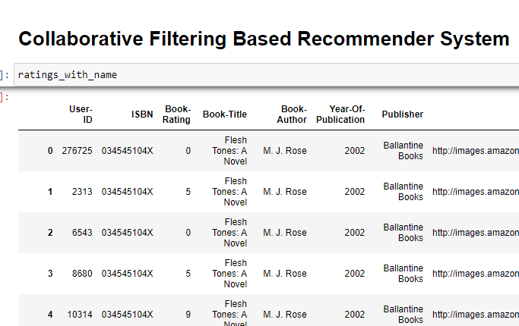
Collaborative Filtering Based Recommender System
In Collaborative Filtering Based Recommender System, We will give value to those users who has given rating more than 200 (Experienced user)
We will consider those books whose rating is more than 50.

Slide 10
Conclusions
Three datasets were given.
Imputed non-sense data as well as null values from Features.
Merged all datasets based on common values from all.
Created a model for recommendation based on previously read book by reader
Using cosine similarity, build model using rating and age values.

Slide 11
Thank you

